Slide 1

Bulk RNA-Seq analysis
Transcriptomics
Leonardo Nossa
Leonardo.nossa@studenti.unimi.it

Slide 2
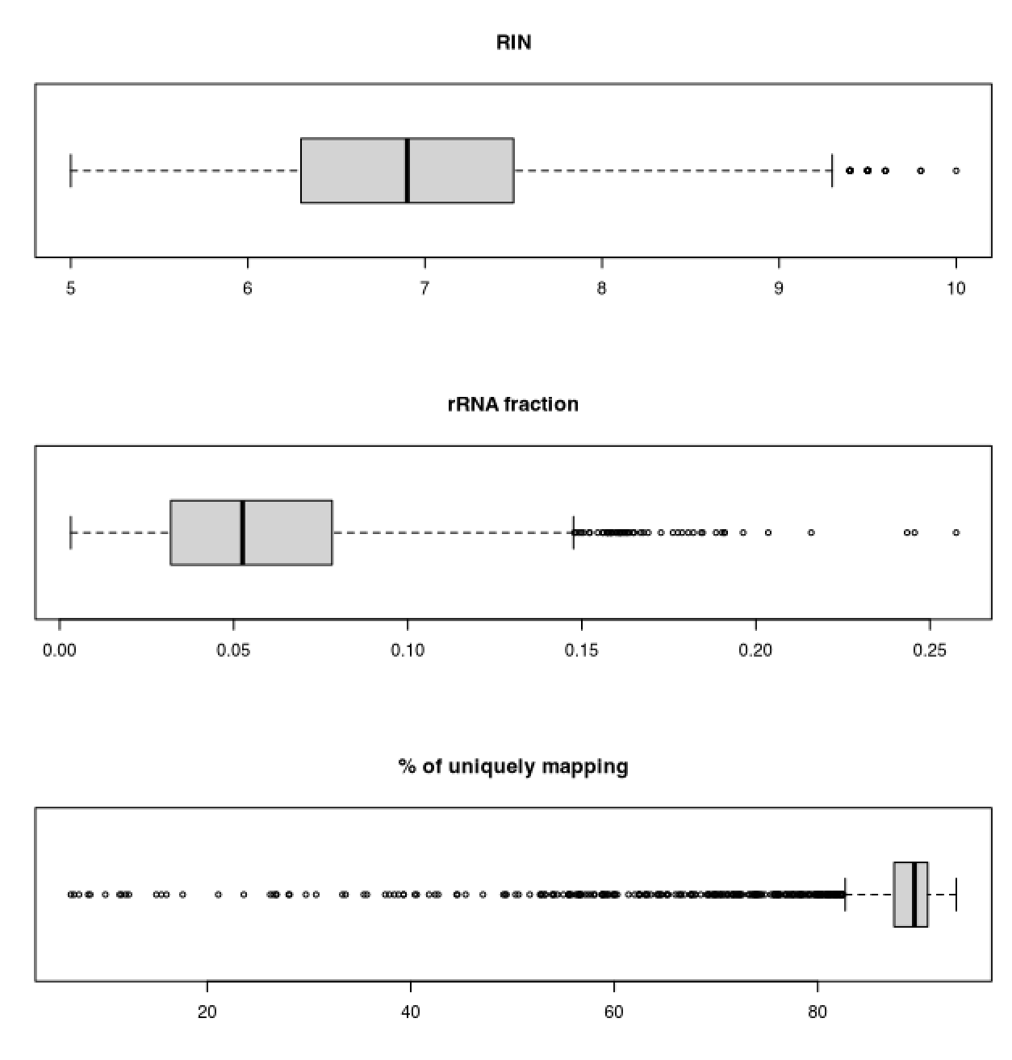
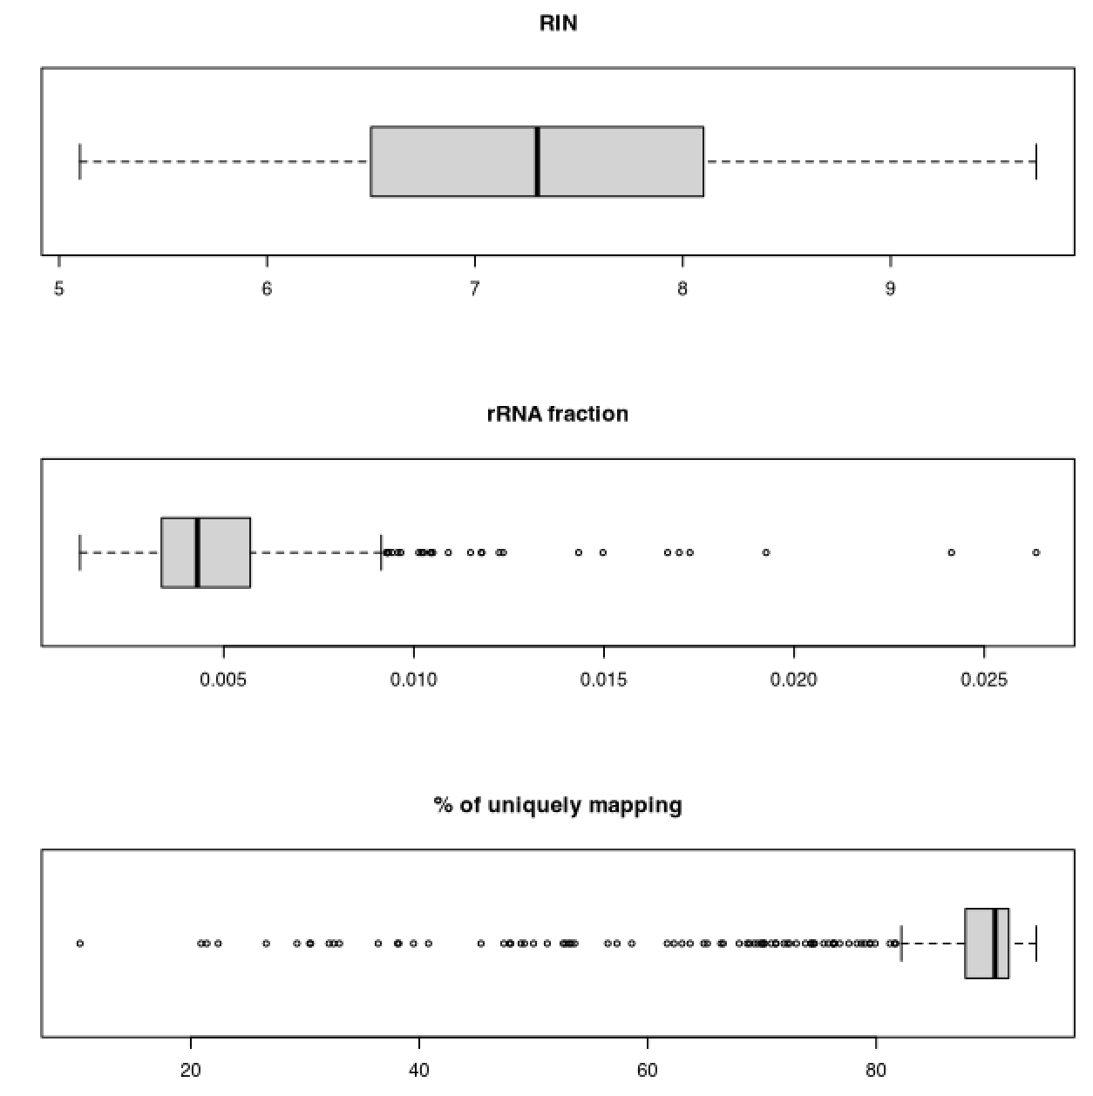
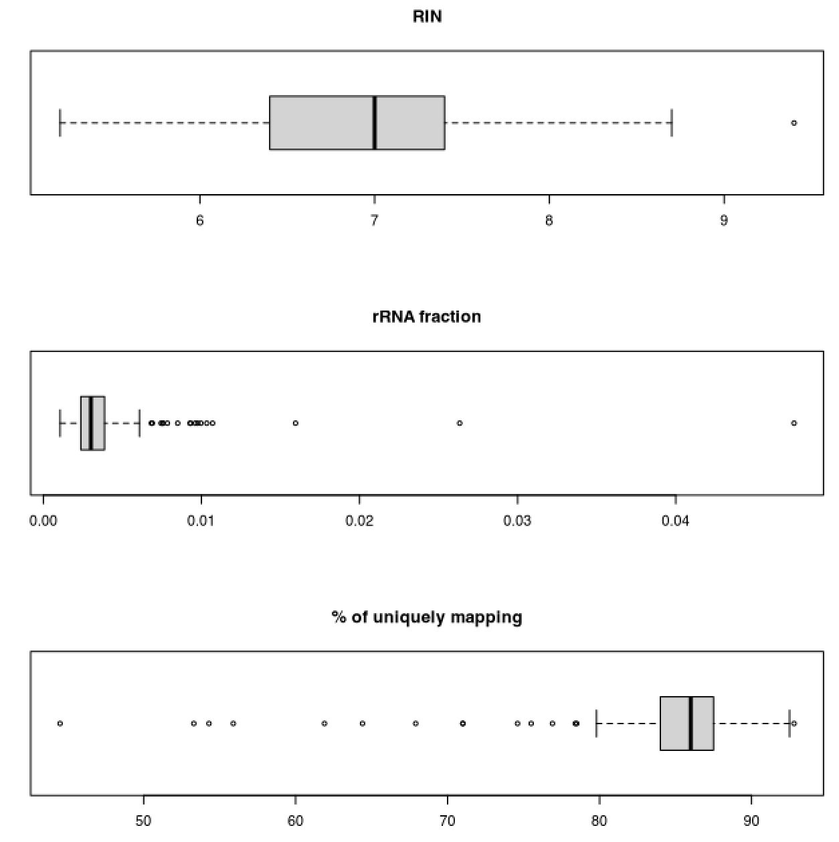
Quality control
BRAIN
LUNG
PANCREAS
Sample | 48 | 49 | 50 | 46 | 47 | 49 | 45 | 47 | 48
RIN | 6.4 | 6.8 | 6.8 | 7.1 | 6.9 | 7.5 | 7.6 | 6.6 | 7.5
% rRNA | 2.8% | 3.5% | 5.5% | 0.4% | 0.3% | 0.3% | 0.3% | 0.2% | 0.3%
% map | 91.5% | 91.5% | 92% | 90% | 86.8% | 89.6% | 86% | 85.4% | 86.7%

Slide 3
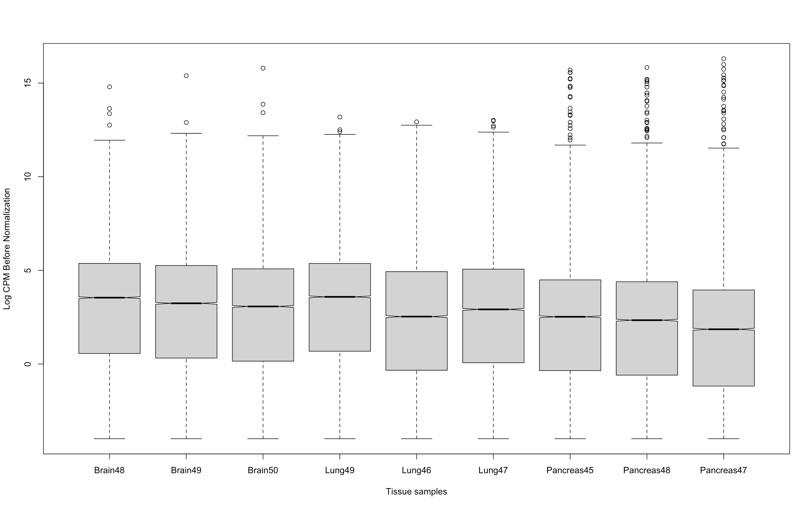
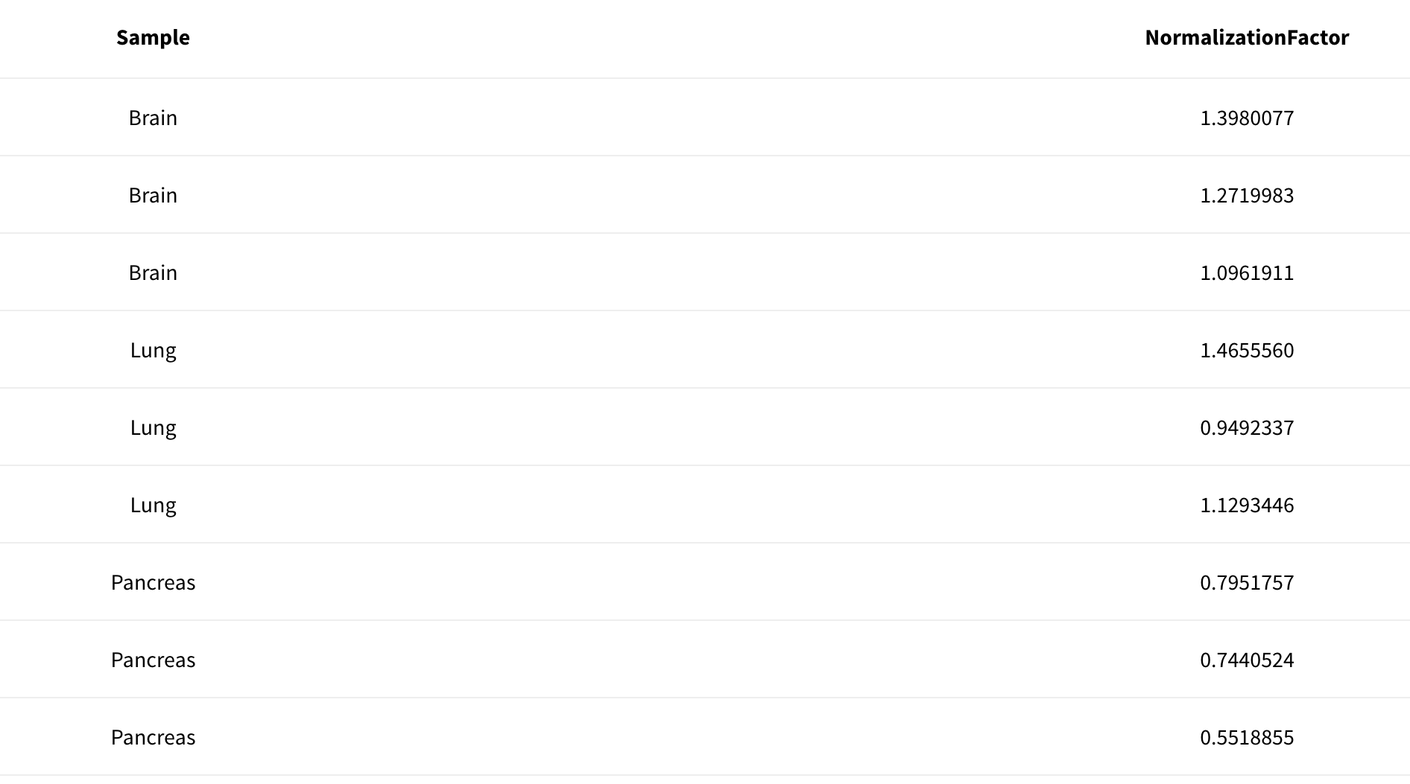
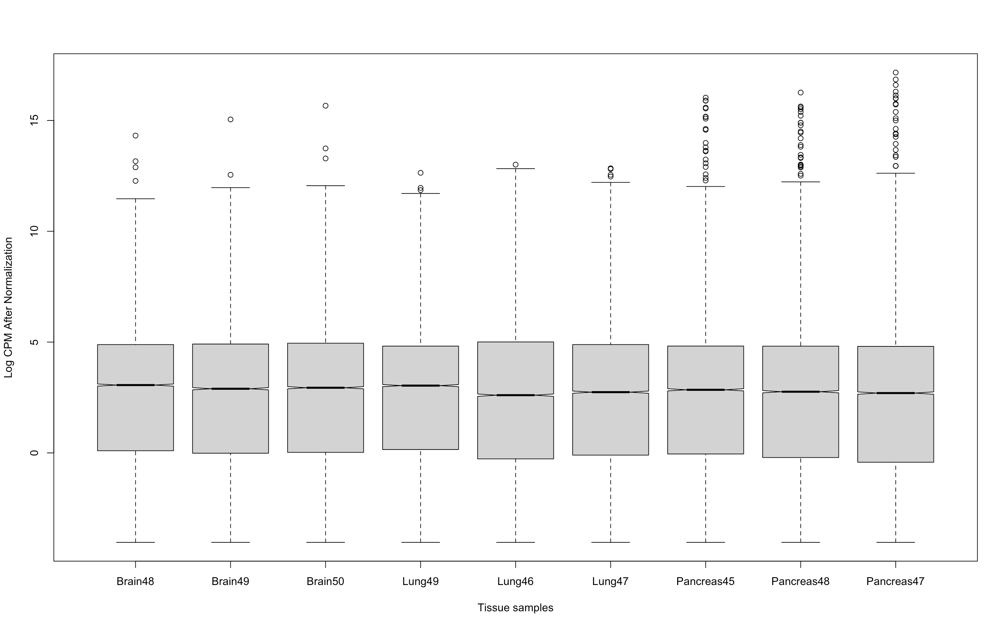
Normalization
Log(CPM) before normalization
Log(CPM) after normalization
Notes:
Why do the normalization?
Correction of Differences in Sequencing Depth
RNA-seq libraries can vary significantly in terms of sequencing depth, that is, the total number of reads obtained for each sample. Normalization on CPMs allows standardization of counts per million reads, making the data comparable between samples with different sequencing depths.
Comparability of Samples
makes expression data comparable between samples, allowing identification of real differences in gene expression due to biological conditions and not technical differences.
Identification of Expressed Genes
helps to identify the genes actually expressed in each sample. Genes with very low counts, which might be noise, are more easily identified and can be filtered out.
TMM (how it work)
Value Trimming: The TMM method truncates extreme count values and genes with very low expression. This helps to remove noise from the data and stabilize the analysis.
Calculation of Scale Factors: After trimming, the TMM method calculates a scale factor for each sample. This factor takes into account the proportion of positive controls within the truncated genes and is used to balance the sequencing depth between samples.
Normalization of Counts: Once scaling factors are calculated, they are applied to the raw counts to normalize the data. This reduces the impact of differences in sequencing depth and RNA composition, allowing more accurate comparison of gene expression between samples.
CODE PART:
logcpm_before <- cpm(y, log=TRUE)
y <- calcNormFactors(y, method = "TMM")
logcpm_after <- cpm(y, log=TRUE)
boxplot(logcpm_before, notch=T, ylab = "Log CPM Before Normalization", xlab = "Tissue samples")
boxplot(logcpm_after, notch=T, ylab = "Log CPM After Normalization", xlab = "Tissue samples")

Slide 4
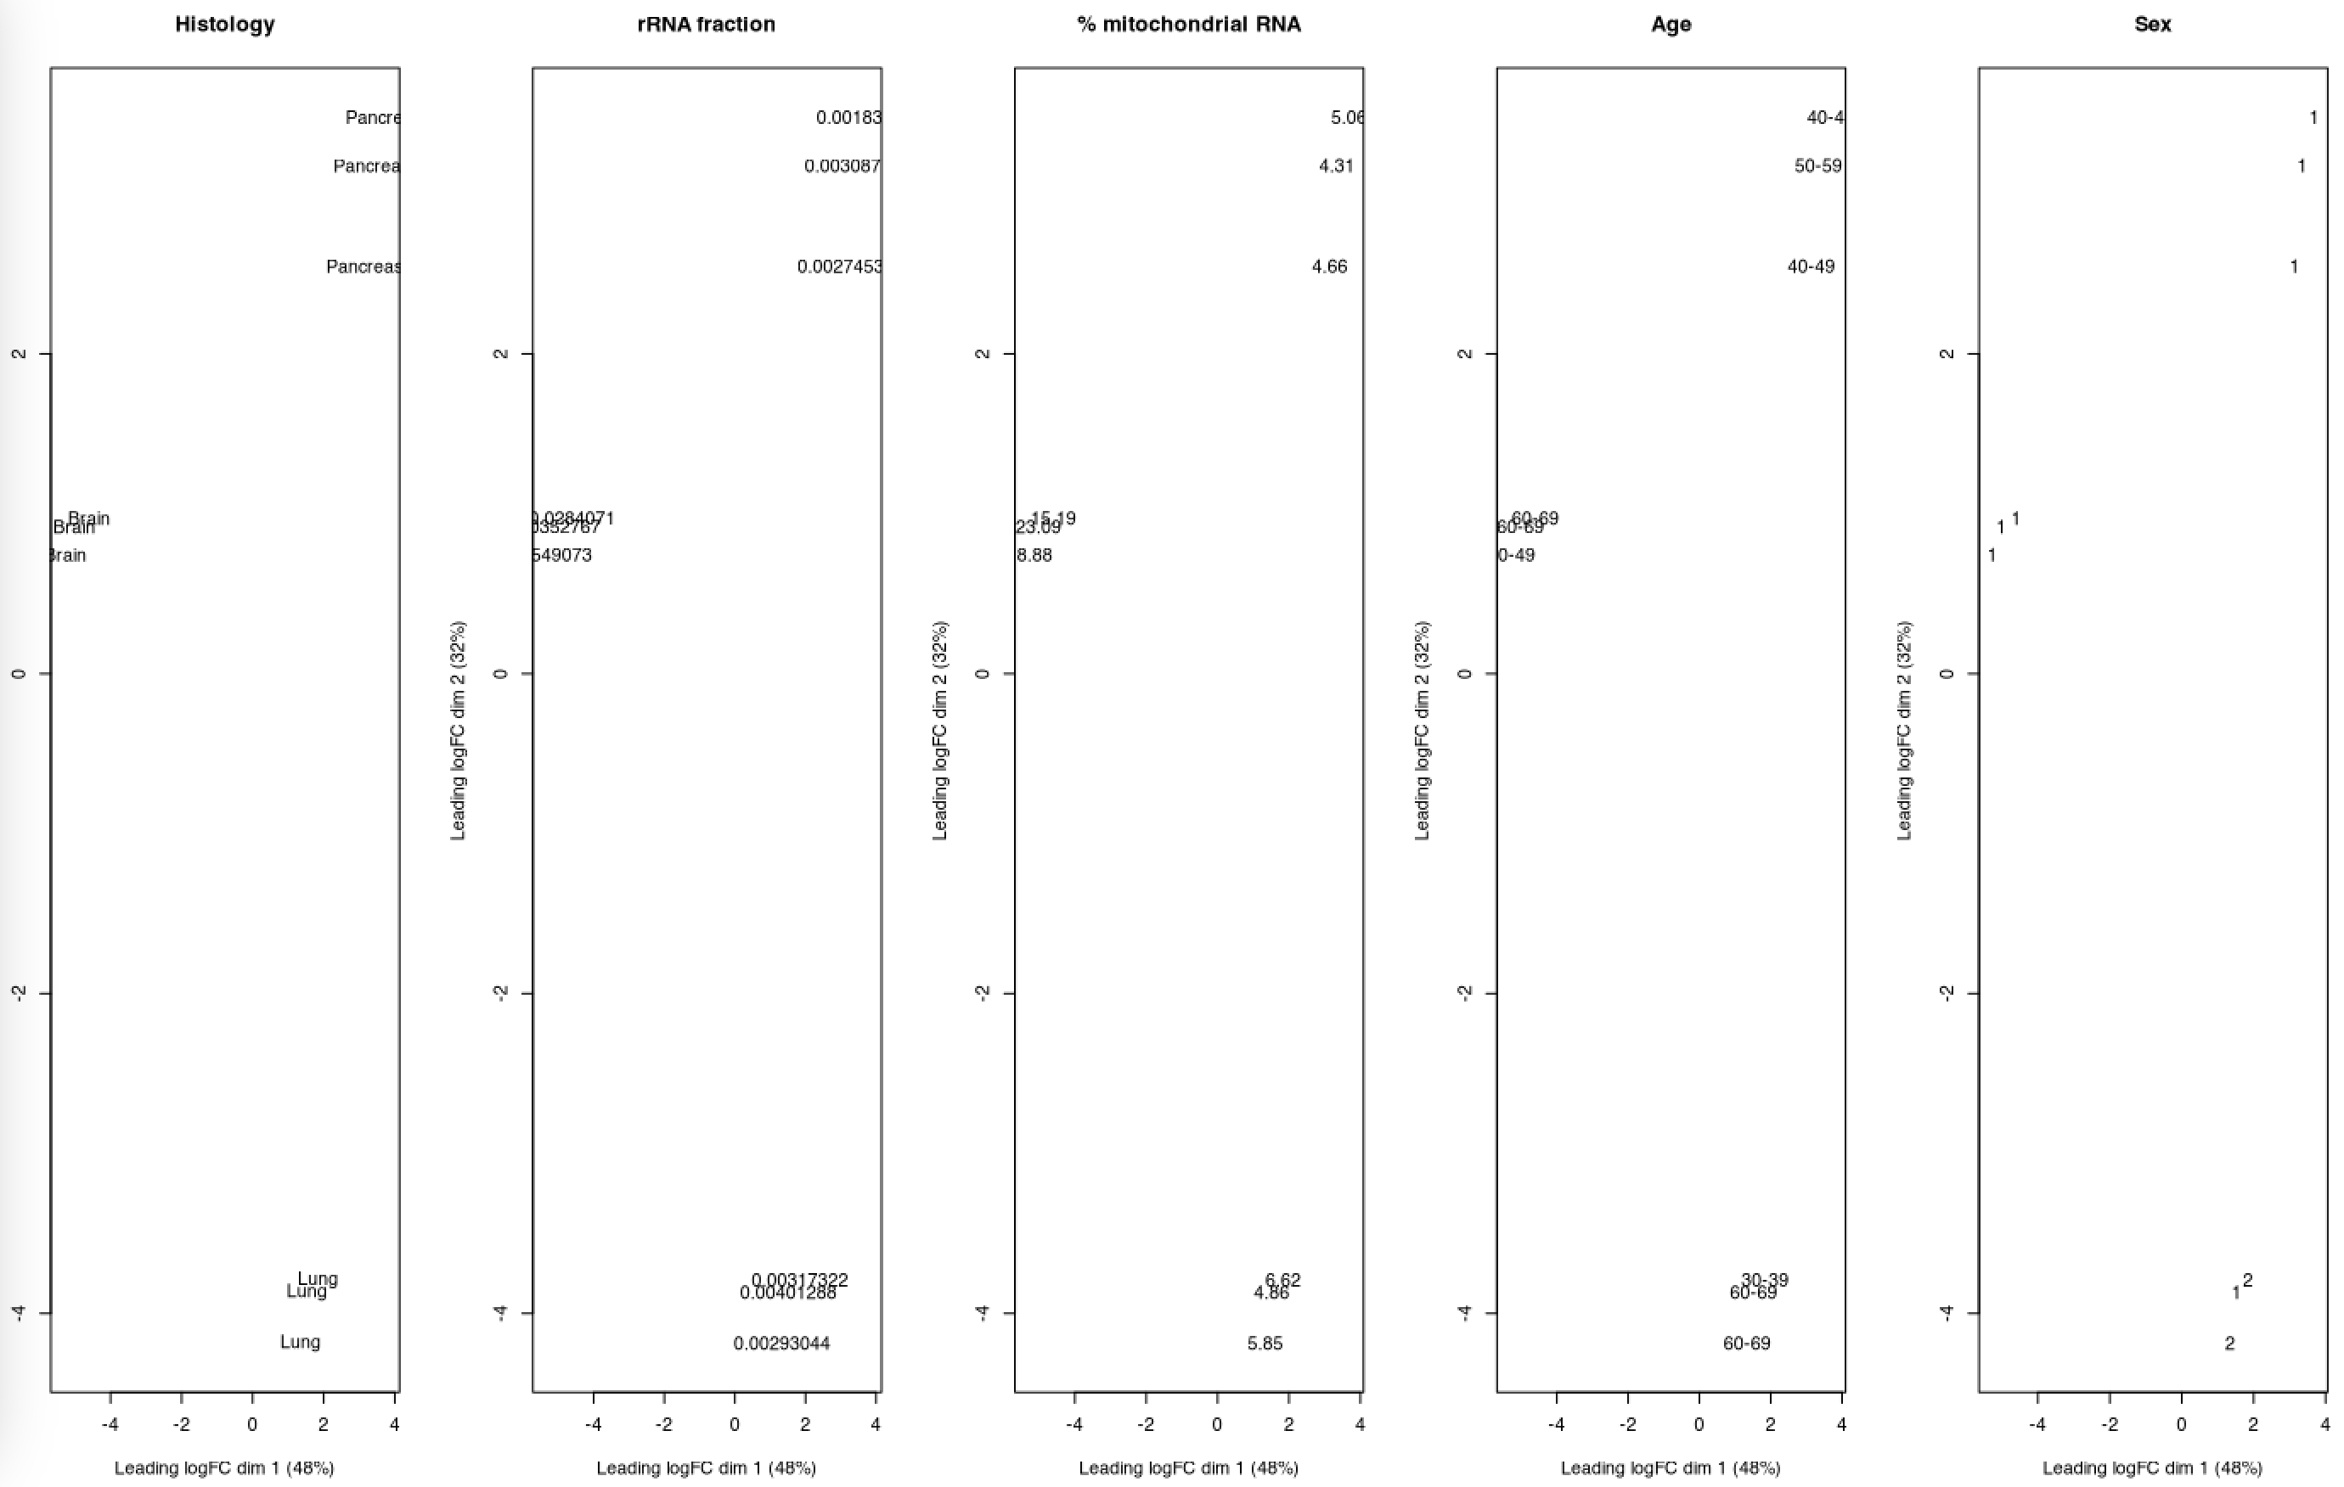
Two-dimensional projection

Slide 5
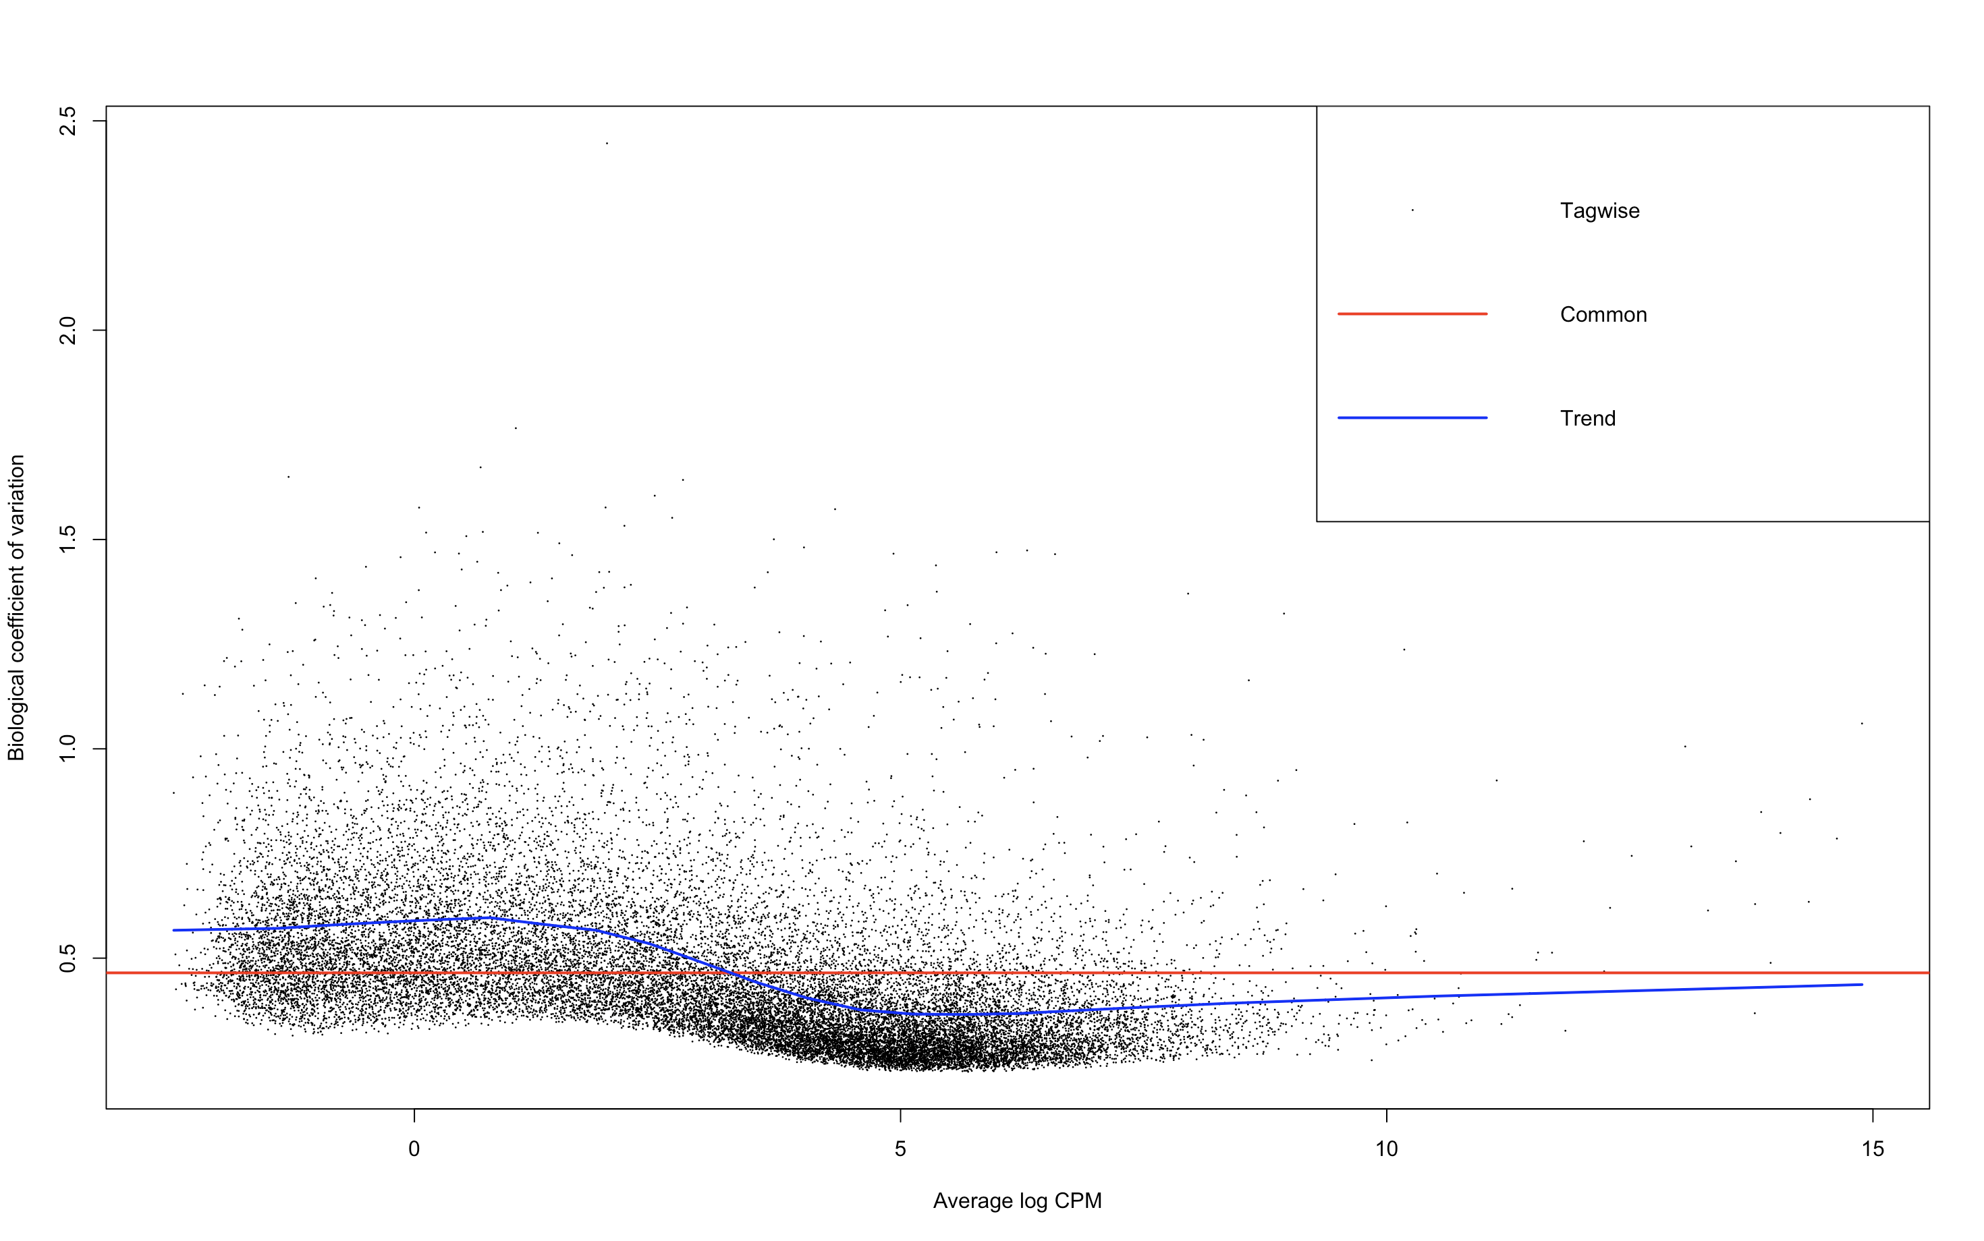
Relationship between mean/variance
Notes:
MATHEMATICAL DEFINITION
BCV is defined as the square root of the dispersion parameter estimated for each gene in the negative binomial model used by edgeR.
It is a critical parameter in RNA-Seq data analysis to account for overdispersion in count data.
Accurate estimation and visualization of BCV help in reliable identification of differentially expressed genes, aiding in the interpretation of RNA-Seq experiments.
MEAN OF THE PLOT
This plot helps in assessing the dispersion of gene expression data, identifying potential outliers, and understanding the relationship between expression level and variability.
TAGWISE
Each gene's BCV is plotted individually (black dots). This shows the individual variability for each gene.
COMMON
The common dispersion is an average BCV across all genes.
TREND
The trend line captures the overall relationship between gene expression level and BCV more accurately than the common dispersion
Variance (Dispersion) Estimation:
In the edgeR package, variance is estimated using three types of dispersion:
Common Dispersion: A single dispersion value applied to all genes.
Tagwise Dispersion: Individual dispersion estimates for each gene.
Trend Dispersion: A smoothed function of the gene abundance.
The plot demonstrates that while the common dispersion provides a single value, it fails to capture the variability observed in individual genes (tagwise dispersion). The trend dispersion offers a middle ground by modeling how dispersion changes with gene expression levels.
CODE PART:
plotBCV(y)

Slide 6
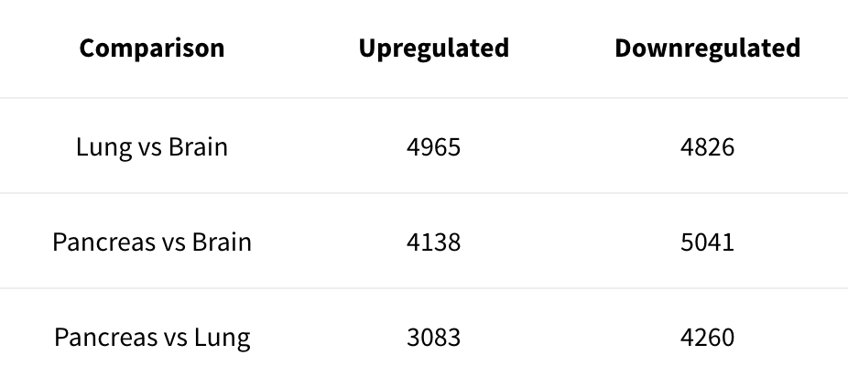
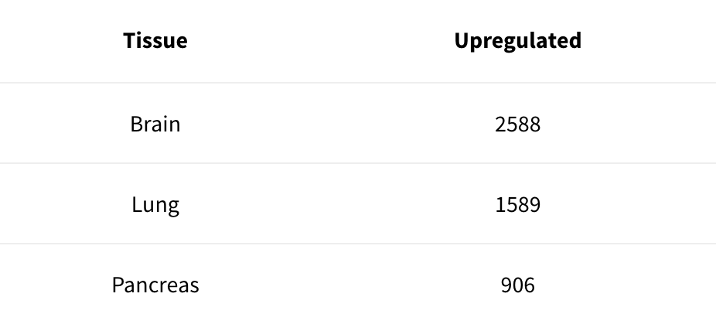
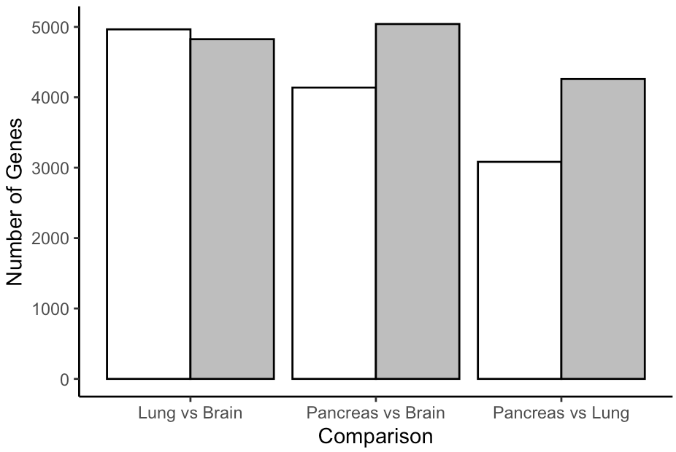
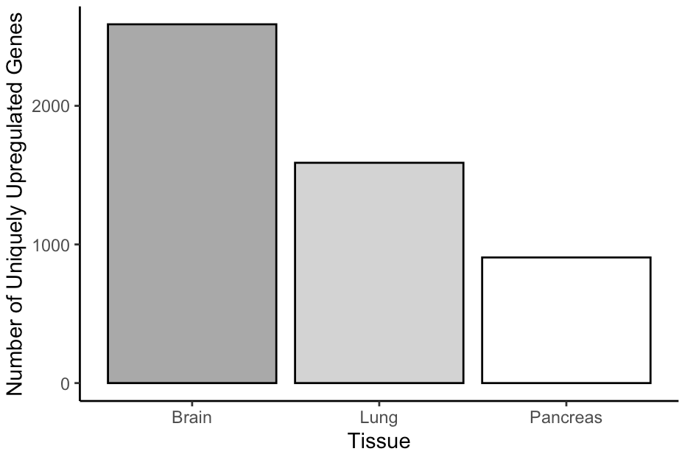
Summarizing DE genes
Number of genes up/down regulated in each comparison
Number of genes resulting to be up regulated in a tissue with respect to both the other two
Upregulated
Downregulated
Notes:
Number of genes up/down regulated in each comparison
I look at the genes that are up- or down-regulated in each comparison. Within the function I created I use a threshold = 0.05, which allows me to filter out genes that have a lower p.value.
Number of genes resulting to be up regulated in a tissue with respect to both the other two
I look at the number of genes that are up-regulated in tissues compared to other tissues
The decideTests test is used in differential gene expression analysis to decide which genes are considered significantly differentially expressed between two conditions or groups.
adjust.method = “BH”: Specifies the correction method for checking false positive rate (FDR). In this case, the correction method used is the Benjamini-Hochberg (BH) method, which is commonly used to control FDR in differential gene expression analysis.
lfc=1: Specifies the minimum fold change value that is considered significant. In this case, only genes with an absolute fold change of at least 1 (i.e., log fold change greater than 0) are being considered as significantly differentially expressed.
P.VALUE AND FDR
In summary, while the p-value provides a measure of significance for individual tests, the FDR provides a measure of the proportion of false positives among all significant tests. Both of these measures are important for correctly interpreting the results of statistical analysis.
In the decideTests function, the p-value and FDR are both used to control statistical significance and control the false-positive rate among genes identified as significantly differentially expressed
My final threshold value for p-value, FDR and fold change would depend on the specific needs of the study and the biological context. Ideally, it would be a choice that balances the discovery of interesting new genes with reducing the risk of false positives.
CODE PART:
design <- model.matrix(~0+group, data=y$samples)
colnames(design) <- levels(y$samples$group)
fit <- glmQLFit(y, design)
#lung (top) vs brain (bottom)
qlfLB <- glmQLFTest(fit, contrast=c(-1,1,0))
#pancreas (top) vs brain (bottom)
qlfPB <- glmQLFTest(fit, contrast=c(-1,0,1))
#lung (top) vs pancreas (bottom)
qlfLP <- glmQLFTest(fit, contrast=c(0,-1,1))
up_down_counts <- function(qlf, threshold = 0.05) {
upregulated <- sum(qlf$table$PValue < threshold & qlf$table$logFC > 0)
downregulated <- sum(qlf$table$PValue < threshold & qlf$table$logFC < 0)
return(c(Upregulated = upregulated, Downregulated = downregulated))
}
counts_LB <- up_down_counts(qlfLB)
counts_PB <- up_down_counts(qlfPB)
counts_LP <- up_down_counts(qlfLP)
comparison_names <- c("Lung vs Brain", "Pancreas vs Brain", "Lung vs Pancreas")
upregulated_counts <- c(counts_LB["Upregulated"], counts_PB["Upregulated"], counts_LP["Upregulated"])
downregulated_counts <- c(counts_LB["Downregulated"], counts_PB["Downregulated"], counts_LP["Downregulated"])
results_df <- data.frame(
Comparison = comparison_names,
Upregulated = upregulated_counts,
Downregulated = downregulated_counts
)
results_melted <- melt(results_df, id.vars = "Comparison")
ggplot(results_melted, aes(x = Comparison, y = value, fill = variable)) +
geom_bar(stat = "identity", position = "dodge", color = "black") +
scale_fill_manual(values = c("white","grey")) +
labs(y = "Number of Genes", x = "Comparison", fill = "Regulation") +
theme_classic()+
theme(legend.position = "none")
kable_up_down = kbl(results_df, align = "c") %>%
kable_material()
test_1 = decideTests(qlfLB, p.value=0.05, adjust.method = "BH", lfc=1)
test_2 = decideTests(qlfPB, p.value=0.05, adjust.method = "BH", lfc=1)
test_3 = decideTests(qlfLP, p.value=0.05, adjust.method = "BH", lfc=1)
upregulated_LB <- which(test_1 == 1)
upregulated_PB <- which(test_2 == 1)
upregulated_LP <- which(test_3 == 1)
up_brain <- setdiff(upregulated_LB, upregulated_PB)
up_lung <- setdiff(upregulated_LP, upregulated_LB)
up_pancreas <- setdiff(upregulated_PB, upregulated_LP)
up_dataframe = data.frame(
Tissue = c("Brain", "Lung", "Pancreas"),
Upregulated = c(length(up_brain), length(up_lung), length(up_pancreas))
)
ggplot(up_dataframe, aes(x = Tissue, y = Upregulated, fill = Tissue)) +
geom_bar(stat = "identity", color = "black") +
scale_fill_manual(values = c("darkgrey","lightgrey","white")) +
labs(y = "Number of Uniquely Upregulated Genes", x = "Tissue") +
theme_classic() +
theme(legend.position = "none")
up_kable = kbl(up_dataframe, align = "c") %>%
kable_material()

Slide 7
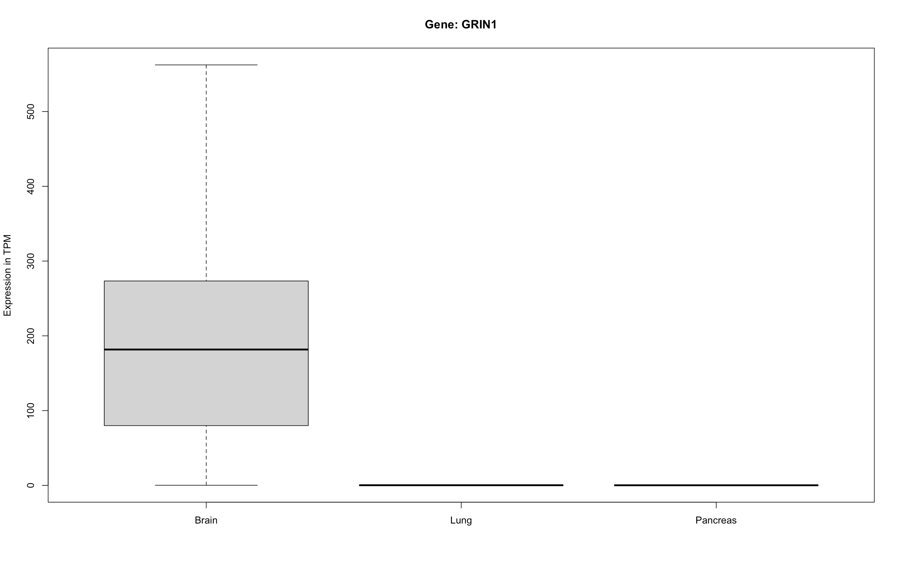
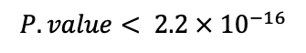
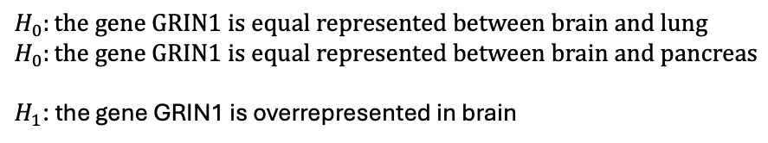
Gene overrepresented in brain – GRIN1
Mann Whitney U Test
$$H_{0}:the gene GRIN1 is equal represented between brain and lung$$
$$H_{0}:the gene GRIN1 is equal represented between brain and pancreas$$
$H_{1}$: the gene GRIN1 is overrepresented in brain
$$P.value< 2.2 × {10}^{−16}$$
So, we reject the $H_{0}$, the gene GRIN1 is overrepresented in brain
Notes:
Per I trascritti alternativi, la lettura:
La direzione delle frecce mi indica lo strand sul quale ho il tracsritto annotato (in questo caso le frecce vanno da sinistra verso destra quindi sono sul forward strand +)
TSS sono uguali
TTS sono uguali (ci sono inizi leggeremente diversi dei siti di poliadenilazione)
Ce la presenza di esoni cassetta ( all’inizio degli ultimi due trascritti e anche verso la fine del terzo e dell’ultimo)

Slide 8
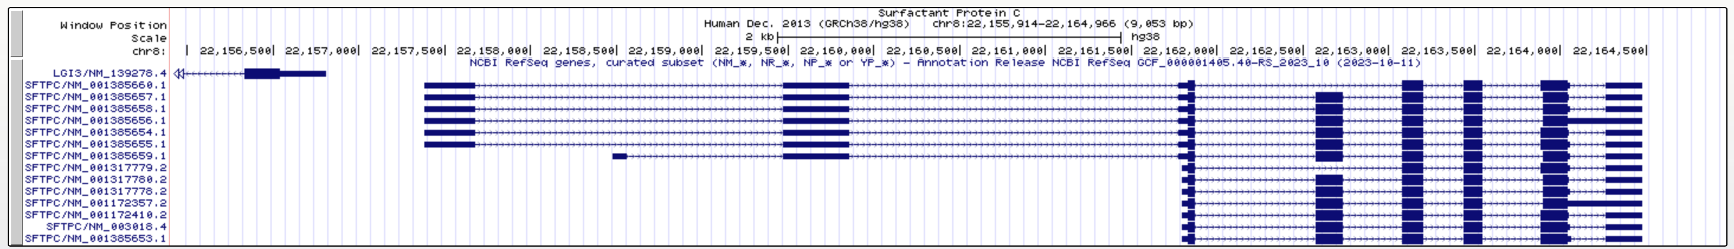
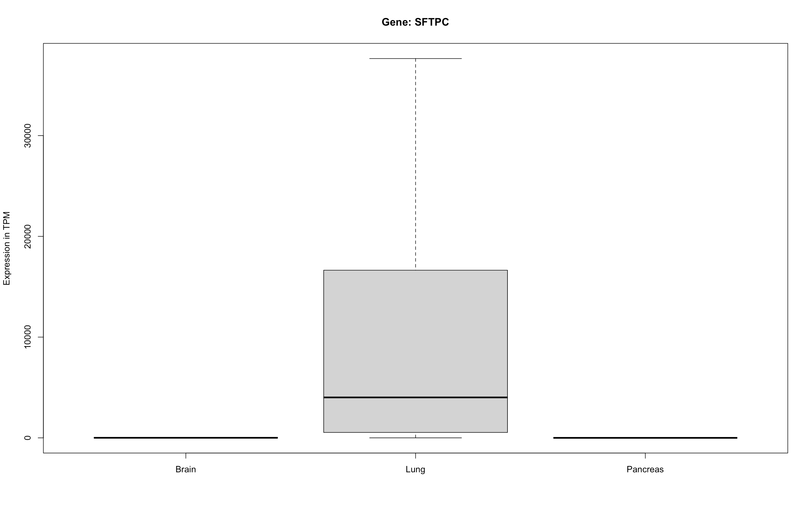
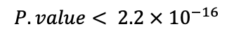
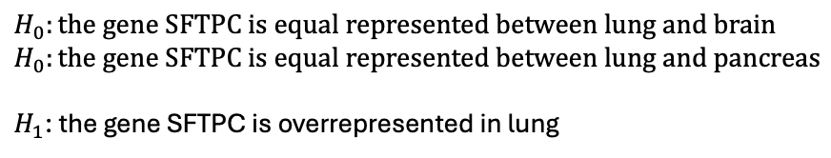
Gene overrepresented in lung - SFTPC
Mann Whitney U Test
$$H_{0}:the gene SFTPC is equal represented between lung and brain$$
$$H_{0}:the gene SFTPC is equal represented between lung and pancreas$$
$H_{1}$: the gene SFTPC is overrepresented in lung
$$P.value< 2.2 × {10}^{−16}$$
So, we reject the $H_{0}$, the gene SFTPC is overrepresented in brain
Notes:
Per I trascritti alternativi, la lettura:
La direzione delle frecce mi indica lo strand sul quale ho il tracsritto annotato (in questo caso le frecce vanno da sinistra verso destra quindi sono sul forward strand +)
Ho tre promotori diversi, ma il punto di inizio della trascrizione sembrerebbe essere lo stesso
TTS sono uguali
Ce la presenza di esoni cassetta
Ce la presena di introni ritenuti

Slide 9
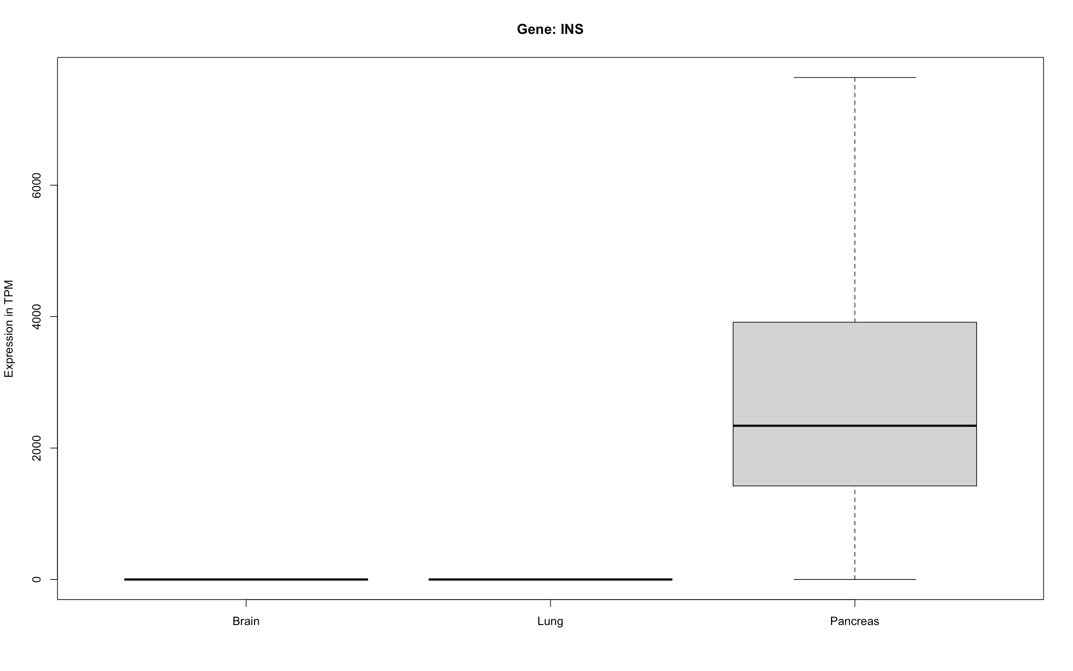
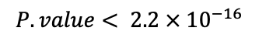
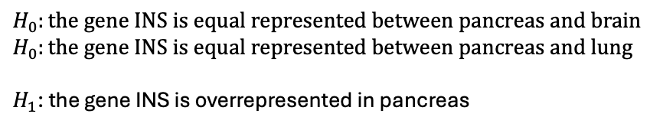
Gene overrepresented in pancreas - INS
Mann Whitney U Test
$$H_{0}:the gene INS is equal represented between pancreas and brain$$
$$H_{0}:the gene INS is equal represented between pancreas and lung$$
$H_{1}$: the gene INS is overrepresented in pancreas
$$P.value< 2.2 × {10}^{−16}$$
So, we reject the $H_{0}$, the gene INS is overrepresented in brain
Notes:
Per I trascritti alternativi, la lettura:
La direzione delle frecce mi indica lo strand sul quale ho il tracsritto annotato (in questo caso le frecce vanno da destra verso sinistra quindi sono sul reverse strand -)
TSS sono uguali (differenti promotori)
TTS sono uguali
Presenza di un introne ritenuto

Slide 10
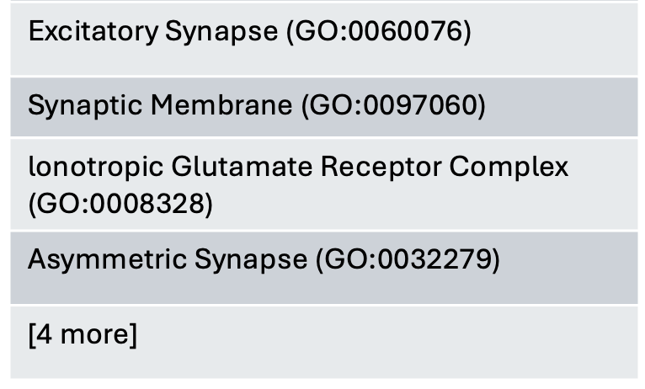
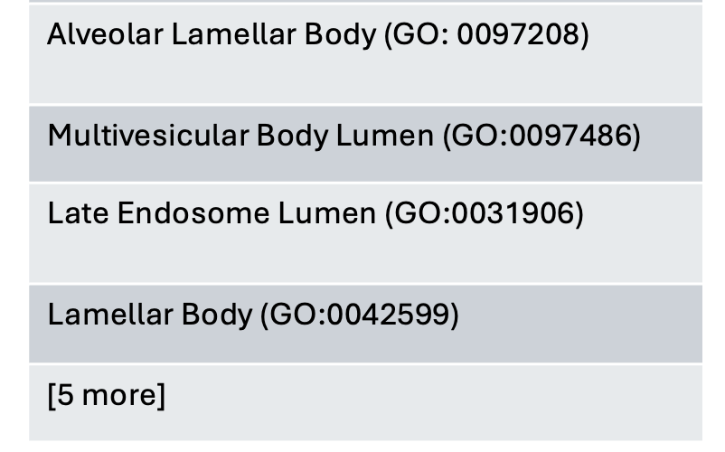
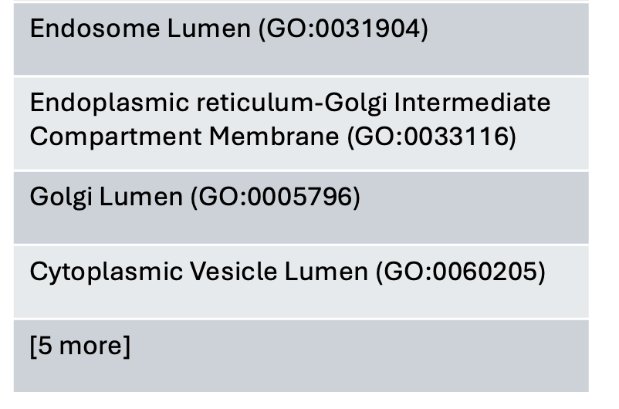
GO annotations
Gene name and symbol
Glutamate Ionotropic Receptor NMDA Type Subunit 1 – GRIN1
Glycine Binding (GO:0016594)
Ligand-Gated Channel Activity (GO:0022834)
Ionotropic Glutamate Receptor Activity (GO:0004970)
Ligand-Gated Calcium Channel Activity (GO:0099604)
[6 more]
Surfactant Protein C - SFTPC
Cis-Regulatory Region Sequence-Specific DNA Binding (GO:0000987)
RNA Polymerase II Cis-Regulatory Region Sequence-Specific DNA Binding (GO:0000978)
RNA Polymerase II Transcription Regulatory Region Sequence-Specific DNA Binding (GO:0000977)
Insulin – INS
Insulin-Like Growth Factor Receptor Binding (GO:0005159)
Hormone Activity (GO:0005179)
Protease Binding (GO:0002020)
Receptor Ligand Activity (GO:0048018)
Molecular function
Cellular component

Slide 11
Functional enrichment analysis over top 500 DE genes
BRAIN
LUNG
PANCREAS
 | GO annotation | Freq. | FDR | GO annotation | Freq. | FDR | GO annotation | Freq. | FDR
Biological process | positive regulation of glial cell-derived neurotrophic factor production | 2/2 | 3.15E-02 | regulation of AIM2 inflammasome complex assembly | 3/5 | 4.12E-03 | exocrine pancreas development | 4/7 | 3.69E-03
Molecular function | outward rectifier potassium channel activity | 5/27 | 2.84E-02 | 2'-5'-oligoadenylate synthetase activity | 3/3 | 2.05E-03 | alpha-amylase activity | 5/5 | 1.16E-05
Cellular component | juxtaparanode region of axon | 4/12 | 2.00E-03 | complement component C1 complex | 3/3 | 3.87E-04 | Hrd1p ubiquitin ligase ERAD-L complex | 3/6 | 9.35E-03

